Slide 1
IBM University Engagement Project Submission
“Exploring the Power of Machine Learning with IBM Cloud”

Slide 2

Project Tile –AI-Driven Precision Crop Recommendation
Domain of Project – Agriculture
Student Name | Recent Passport Photo | Email ID | Mobile number [WhatsApp]
PRAJAKA BRAMHANE |  | bramaneprajakta9@gmail.com | 8855870402

Slide 3
Problem Statement -
Traditional Agricultural Challenges: Traditional crop selection relies heavily on historical habits or broad-regional manual soil tests with long reporting backlogs. This leaves farmers highly vulnerable to localized climate fluctuations and rapid soil degradation.
The Inefficiency Risk: High variance in accuracy, slow turnaround times, and vulnerability to sudden weather changes can lead to localized crop failures, poor yields, and severe financial risk.
The Solution Goal: Design, build, and evaluate an automated multi-class classification pipeline that utilizes localized environmental parameters to quickly and accurately recommend the optimal crop, maximizing regional yield potentials while preserving resources.

Slide 4
Proposed Solution -
IBM Cloud & watsonx.ai Studio: Provides the scalable, secure cloud infrastructure to build, automatically optimize, deploy, and scale the predictive model endpoints using AutoAI.
Machine Learning Model: Optimized LightGBM Classifier Ensemble.
System Performance: Achieved a top Accuracy of 99.1% via automated hyperparameter tuning.
Enhancements & Pipeline Tuning: AutoAI-driven automated data preprocessing, feature engineering (FE), algorithm selection, and hyperparameter optimization (HPO-1).
User Interface: Delivered via a responsive, client-facing application.

Slide 5
Technology Used:
IBM Cloud & watsonx.ai Studio: Provides the scalable, secure cloud infrastructure to build, automatically optimize, deploy, and scale the predictive model endpoints using AutoAI.
Machine Learning Model: Optimized LightGBM Classifier Ensemble.
System Performance: Achieved a top Accuracy of 99.1% via automated hyperparameter tuning.
Enhancements & Pipeline Tuning: AutoAI-driven automated data preprocessing, feature engineering (FE), algorithm selection, and hyperparameter optimization (HPO-1).
User Interface: Delivered via a responsive, client-facing application.

Slide 6
Dataset & Structural Framework - Reference Dataset: Crop_recommendation.csv System Input Parameters:
Metric Name | Type | Description | Agronomic Relevance
N (Nitrogen) | Numerical | Ratio of Nitrogen content in soil (mg/kg) | Encourages robust leaf and vegetative development
P (Phosphorus) | Numerical | Ratio of Phosphorus content in soil (mg/kg) | Improves root development and seed creation
K (Potassium) | Numerical | Ratio of Potassium content in soil (mg/kg) | Controls water retention and disease resistance
temperature | Float | Environmental temperature (°C) | Controls photosynthetic rates and crop metabolism
humidity | Float | Relative humidity (%) | Governs transpiration and moisture balance
ph | Float | pH value of localized target soil | Dictates nutrient solubility and root absorption
rainfall | Float | Total volume of precipitation (mm) | Primary source of hydration for crop growth

Slide 7
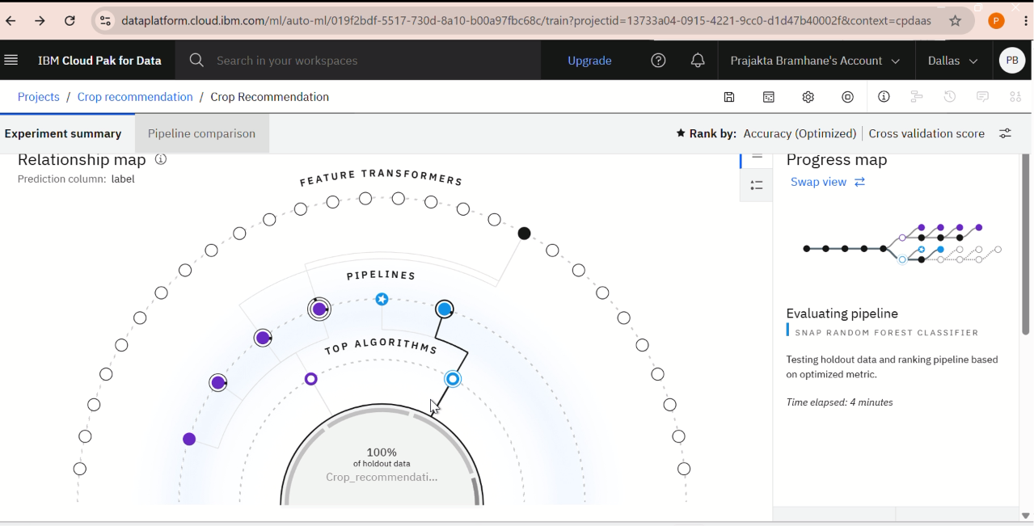
Training Screenshots-

Slide 8
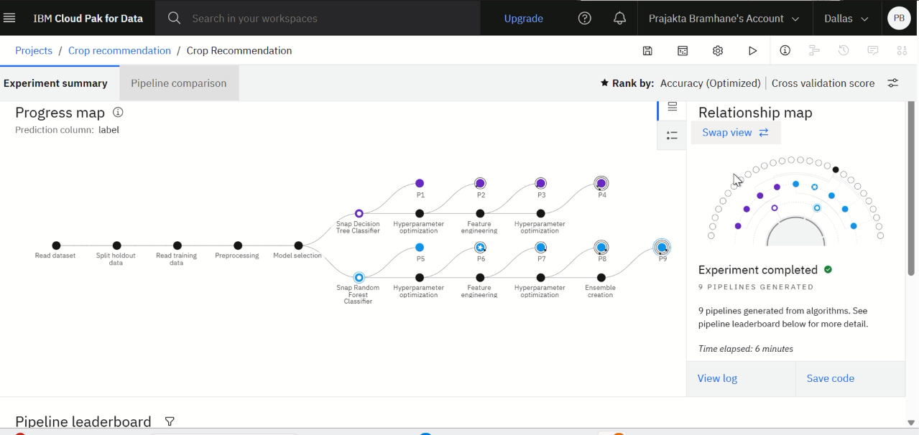

Slide 9
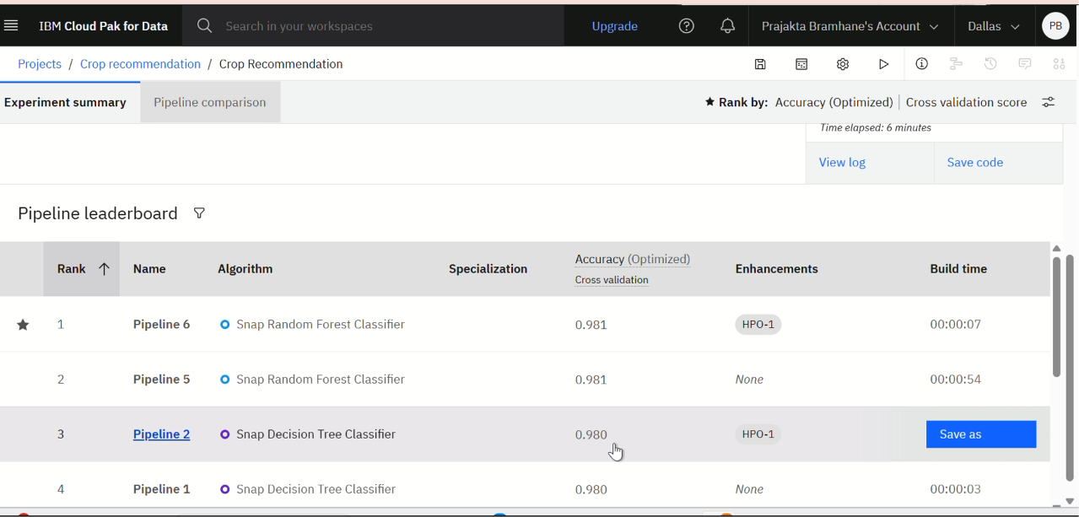
Best Model Screenshot:

Slide 10
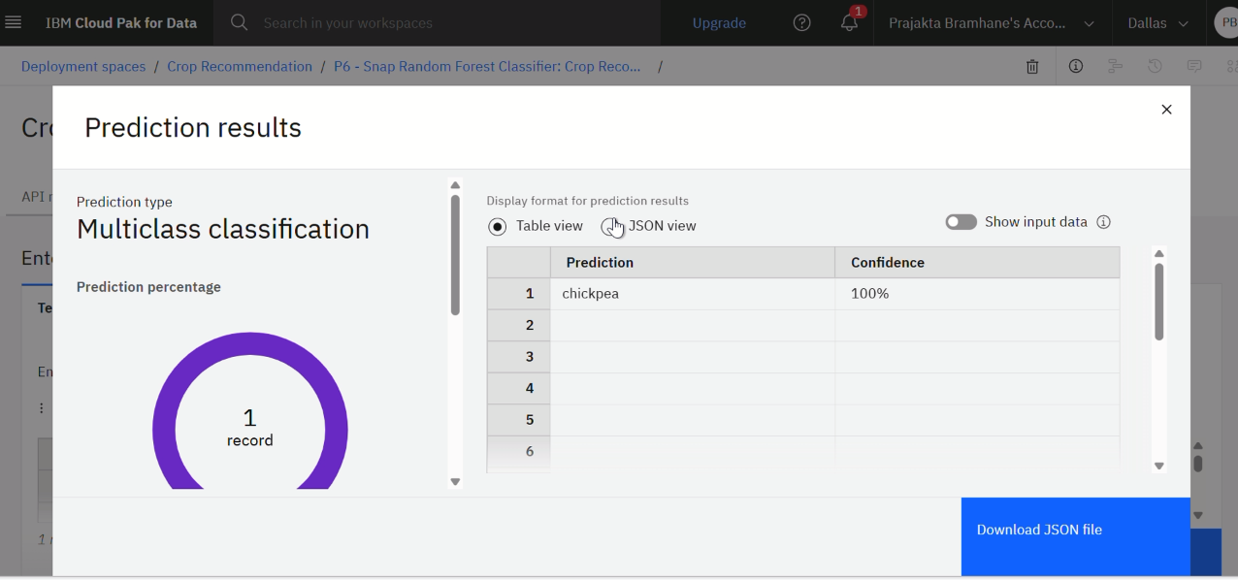
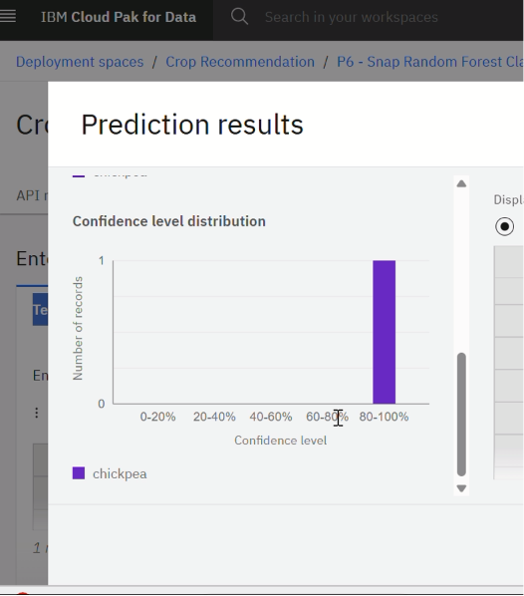
Testing Screenshot:

Slide 11
Novelty and Uniqueness:
End-to-End Automation: Automates precision crop identification, removing manual verification backlogs and human guessing from the workflow.
No-Code Machine Learning Pipeline: Leverages IBM watsonx.ai AutoAI to automatically uncover the best classification model (LightGBM) without extensive manual coding.
Intelligent Platform Consolidation: Multi-class classification processes 7 independent environmental parameters through a single intelligent layer to cleanly map to discrete target crop categories.
Unbiased Engineering: Automated feature engineering extracts hidden soil-climate patterns, ensuring consistent, data-backed farming decisions.

Slide 12
Git Hub Link:
https://github.com/PRAJ-u/crop-reccomdation.git

Slide 13
Future Scope:
1. IoT Integrations: Integrate live automated telemetry sensors directly into farm soil beds to stream soil parameters dynamically.
2. Dynamic APIs: Incorporate real-time local weather forecasting and GPS-tracked precipitation APIs directly into the pipeline.
3. Global Scaling: Expand historical datasets to include localized tropical, arid, and specialty crops to scale the system nationwide and globally.
4. Mobile Deployment: Expose native iOS/Android client apps supporting localized regional languages to break technology barriers for growers.
·

Slide 14
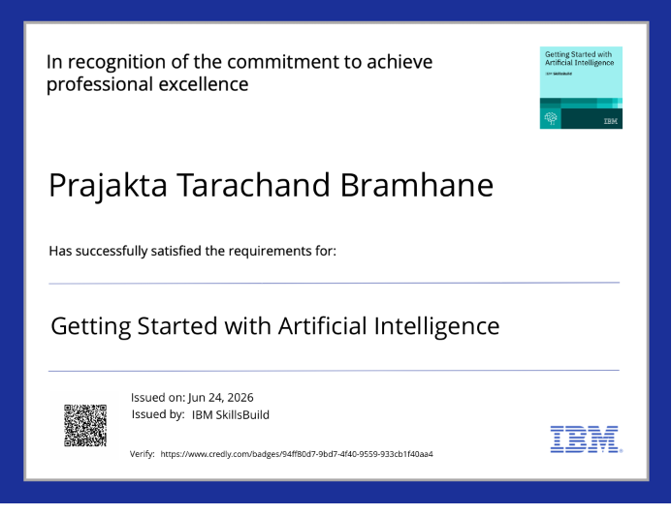
Certificates Earned:

Slide 15
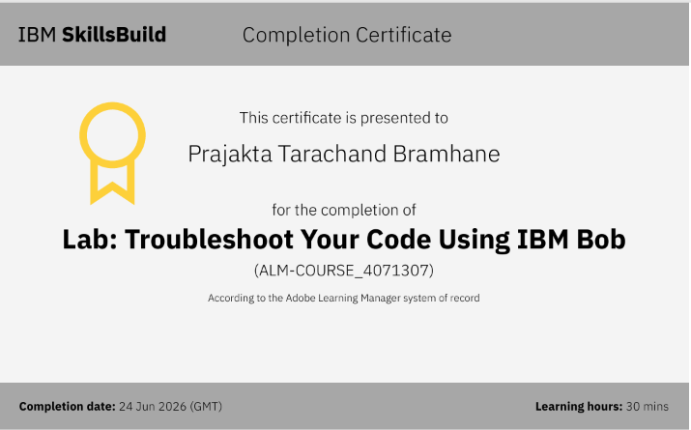
Certificates Earned:​

Slide 16


